Slide 1
Final Project
IST722 Group 4
Connor Gendron
Andrew Zelazny
Ryan Fisher
Charles Vanleuvan

Slide 2
Summary
Project Charter and Overview
Business processes and Facts overview
Star Schema setup
ETL process
Cube setup
Power BI dashboard demo
Insights

Slide 3
Overview and Project Charter
Fudgemart and Fudgeflix are merging, and so we need to integrate both companies business processes to create one fully functional DW without losing either company’s data
Business Requirements: Customer and account revenue analysis for both FM and FF
Functional requirements:
Business users must be able to analyze total customer revenue across business segments
Users must be able to interact with visuals to aid in data-driven decision making regarding revenue
Users must be able to access both Fudgemart and Fudgeflix data in one source

Slide 4
Business Process and Facts
5 business processes were identified
Product Sales by department at Fudgemart
Product Inventory snapshot for Fudgeflix
Customer product reviews
Account billing revenue for account plan types for Fudgeflix
Fudgemart sales and Fudgeflix services billing for overall sales
Fudgemart sales and Fudgeflix services were chosen for integration in a data warehouse and visualization in PowerBI

Slide 5
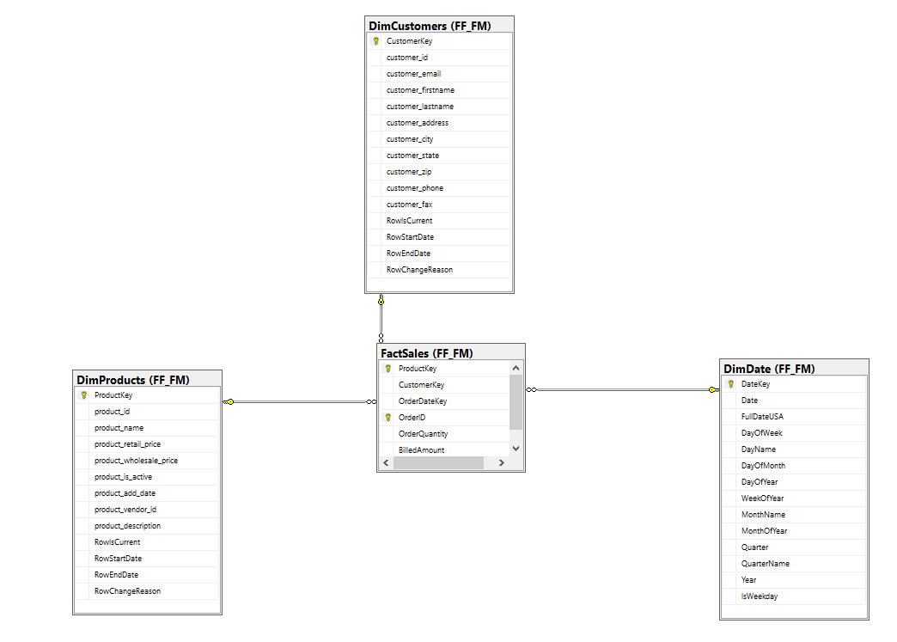
Star Schema Setup
Business Process: Fudgemart Sales and Fudgeflix Account Billing
Integrated sales between Fudgemart and Fudgeflix
Consolidated FM customers and FF accounts to 1 Customer dimension
Consolidated FM Products and FF Plans to 1 Product Dimension
FF account billing and FM order dates consolidated to 1 date dimension
Facts: Order quantity and Billed Amount
Dimensions: Customer, Product, Date

Slide 6
ETL Process
High level summary:
Create DimDate from ExternalSources
Create DimProducts
Conformed dimension from Fudgemart products and Fudgeflix plans
Create DimCustomers
Conformed dimension for Fudgemart and Fudgeflix Customers
Stage data from Fudgemart orders and order_details
Stage data from Fudgeflix account_billing
Merge Fudgemart order_details with Fudgeflix account_billing in stage
Create FF_FM_FactSales in data warehouse from merged data in stage

Slide 7
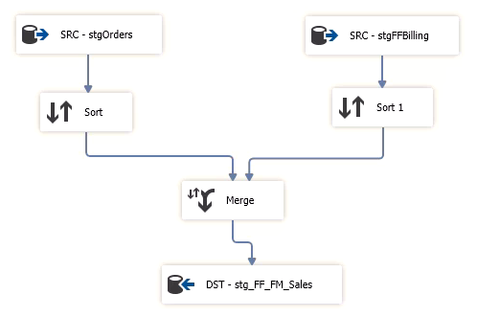
ETL - Merging Customers
Merge customer data from Fudgemart and Fudgeflix
Merge on customer_id, first name, last name, and address

Slide 8
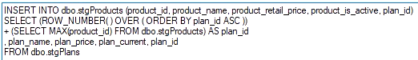
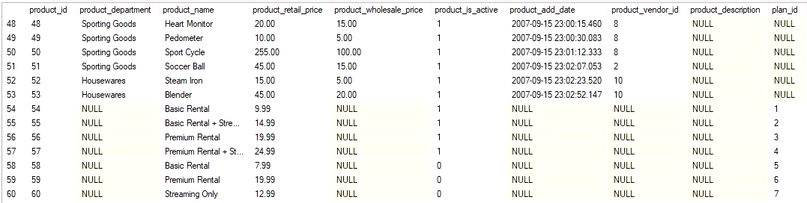
ETL - Merging Products
Import plans from Fudgeflix to stage
Duplicates between plan_id in Fudgeflix and and product_id Fudgemart!
Resolve by insert plans into products, incrementing by one on each insert
Keep plan_id on insert to create PlanToProductID table

Slide 9
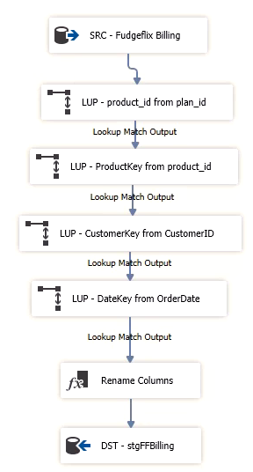
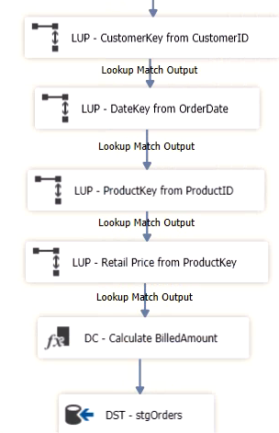

ETL - Merging Orders and Account Billing
Surrogate Key Pipelines created for both Fudgeflix account_billing and Fudgemart Orders
Fudegflix
OrderQuantity set to 1
BilledAmount pulled from account_billing
Fudgemart
OrderQuantity pulled from order_details
Map retail price based on ProductKey
BilledAmount calculated from retail_price * OrderQuantity
Data then merged and deployed to FF_FM_FactSales

Slide 10
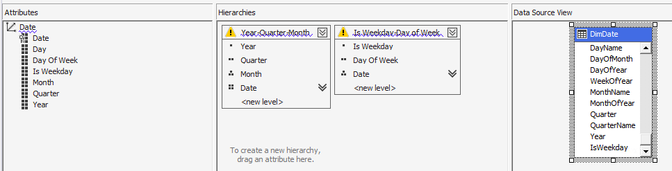
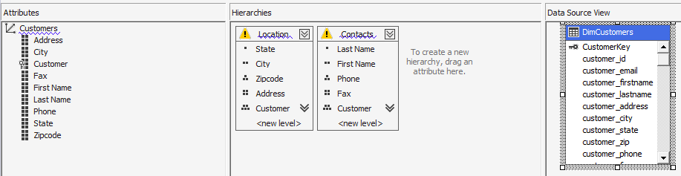
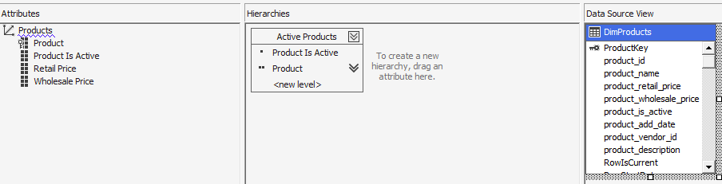
MOLAP Dimensions and Hierarchies

Slide 11
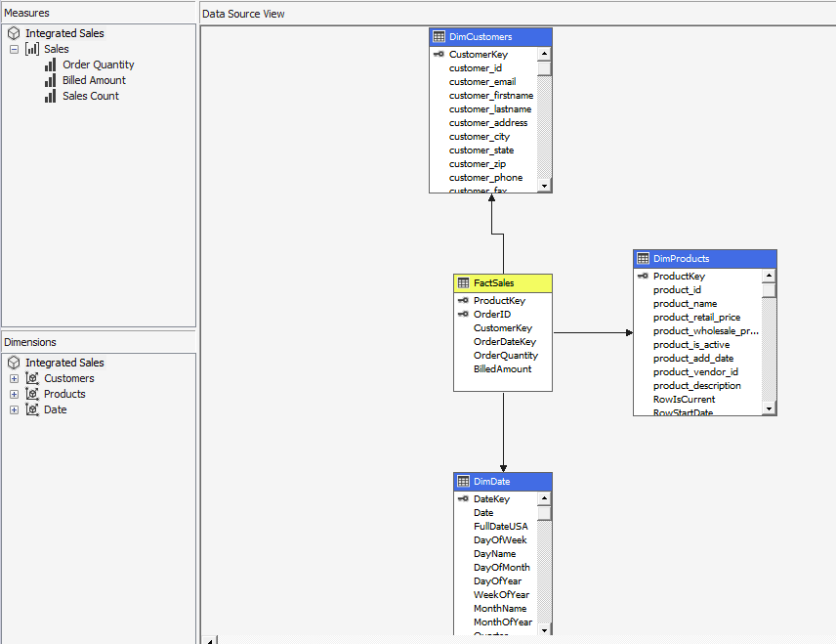
MOLAP Cube Structure
The cube incorporates our three dimensions: customers, products and dates.
Each dimension has at least one incorporated hierarchy, for example years contain quarters which contain months etc.
Because the cube is user facing it displays product name instead of product ID and customer email instead of customer ID.
The MOLAP cube is a useful standalone user interface for exploring the data and can also be connected to other programs for more in depth BI applications.

Slide 12
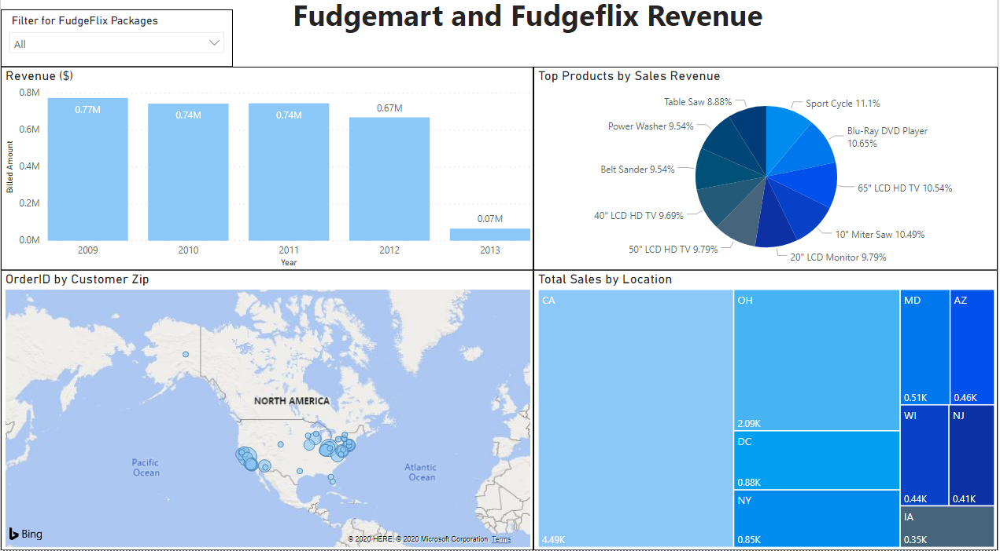
Dashboard for BI
The goal was to provide a global view of revenue for the Fudgemart and Fudgeflix sales
Revenue is broken down by date hierarchy as well as location
We have the top grossing sales by product showing whenever a filter is applied
Zip code analysis allows for better diverting of company resources
Link to Report

Slide 13
Insights
Revenue at Fudgemart has been decreasing 2009 - 2012
Next steps would be to take a deep dive into product trends in those years to see which products are dropping off in production
The most fudgeflix plans and fudgemart sales occurred in California
Ohio was second, followed by DC
Interesting that NY was fourth, considering it is a larger market than both DC and OH
The top products in terms of amount of orders placed was Baseball gloves, Sports t- shirts, and running pants

Slide 14

End

